Slide 1
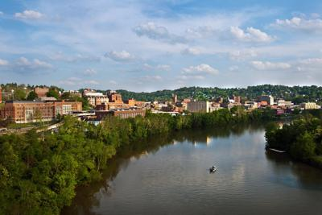
Contextualization of the Monongahela River
MDS 489 Capstone Project with the Headwaters to the Ohio Water Network
Lauren Campbell, Andrew Gamponia, Payton Keys, Victoria Nist, and Tatum Wamsley

Slide 2
Project Background
Graduating seniors enrolled in MDS 489 partnered with the Common Waters Collaborative through the West Virginia Water Research Institute to address community needs through experiential education.
By partnering with watershed groups, students develop a project with real-world impact through incorporating existing data, local knowledge, resources, and physical sites for research.

Slide 3
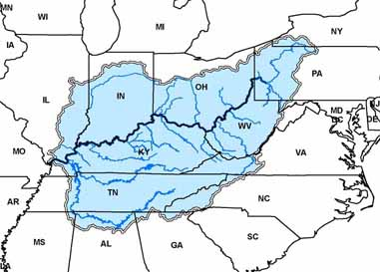
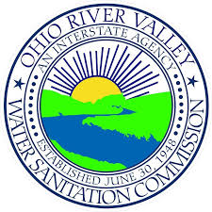
Ohio River Basin
Ohio River is 981 miles in length
Begins at the confluence of the Allegheny and the Monongahela Rivers in Pittsburgh, PA and ending in Cairo, IL
More than 30 million people live in the Ohio River Basin
The river is the drinking source for more than five million people
However, "pollution from urban runoff, agricultural activities, and abandoned mines is a major cause of water pollution" (ORSANCO)

Slide 4
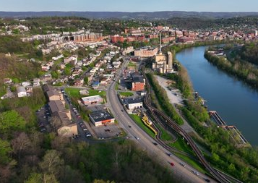
"The Headwaters to the Ohio Water Network connects diverse water stakeholders to develop and pursue a shared vision and attract increased resources for safe and clean water" (H2O Water Network, 2025).

Slide 5
Project Focus

Slide 6
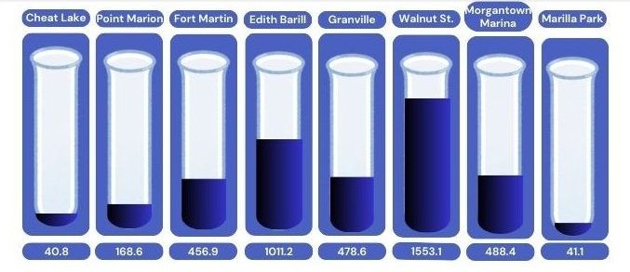
Water Sampling
Water samples were collected on April 8 at eight different locations along the Monongahela River in Morgantown, WV
Fecal coliform levels were determined and represented in most probable number (MNP) per 100 mL of sample

Slide 7
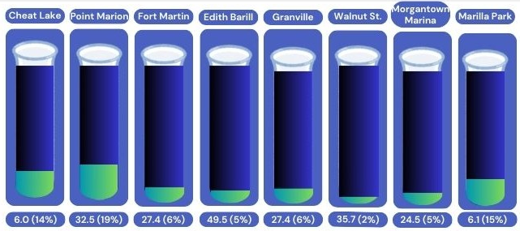
Water Sampling
Water samples were collected on April 8 at eight different locations along the Monongahela River in Morgantown, WV
E. Coli levels were determined for the fecal coliform samples and represented in most probable number (MNP) per 100 mL of sample

Slide 8
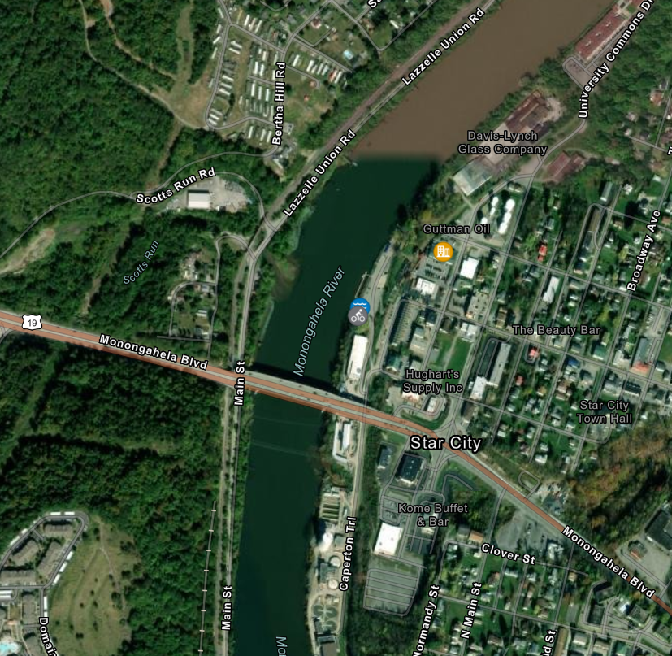
Edith Barill Riverfront Park

Slide 9
Edith Barill Riverfront Park
Leeway St, Star City, WV 26505
In the early 20th century, Star City emerged as an industrial hub, notably for glass manufacturing.
Interestingly, the town was named after the Star Glass Company, one of several facilities in the area (Upper Monongahela River Association, 2019).
A ferry crossing operated at this location, facilitating the movement of workers and goods across the Monongahela River.
The ferry connected Star City residents to coal mines and other industrial sites on the opposite bank (Owen, 2022),

Slide 10
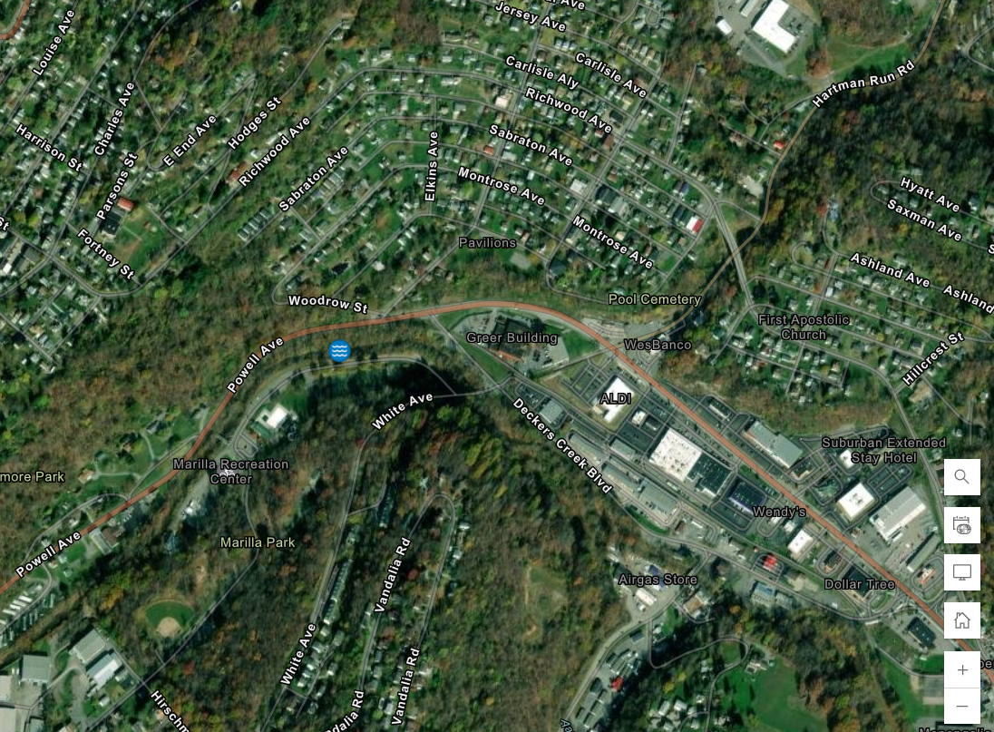
Marilla Park (at Deckers Creek)

Slide 11
Marilla Park (at Deckers Creek)
E Brockway Ave, Morgantown, WV 26501
The area was primarily an industrial and transportation hub. The Saberton community housed a small plate mill, which later became a manufacturing plant for Sterling Faucet.
Saberton, known initially as Sturgiss City and Sabraton Station, was a former coal town named after Sabra Vance Sturgiss, the wife of a local judge (Morgantown BOPARC, 2025).
Saberton was connected to downtown Morgantown by a trolley that ran the length of Richwood Avenue. The land now known as Marilla Park was utilized for industrial purposes or as part of the transportation infrastructure (Morgantown BOPARC, 2025).

Slide 12
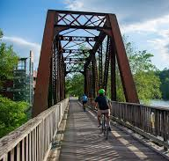
Project Significance
Understanding the history of the Monongahela River in Morgantown will aid the WVU Common Waters Initiative in providing essential information to non-profit organizations, like Headwaters to the Ohio Water Network, in developing new resources to protect the river.

Slide 13
Thank you!
Lauren Campbell, Andrew Gamponia, Payton Keys, Victoria Nist, and Tatum Wamsley

Slide 14
References
H2O Water Network. (2025). Our Mission. Headwaters to the Ohio Water Network. https://h2owaternetwork.org/.
Morgantown BOPARC. (2025). Marilla Park. Morgantown Board of Parks and Recreation. https://www.boparc.org/marilla-park.html?utm_source=chatgpt.com.
ORSANCO. (2025). River Facts. Ohio River Valley Sanitation Commission. https://www.orsanco.org/river-facts/.
Owen, B. (15 June 2022). Pre-Star City. The Historical Marker Database. https://www.hmdb.org/m.asp?m=200075.
Upper Monongahela River Association. (2019, September 1). Topics for ten wayside interpreting this history of Star City and its riverfront along the Monongahela River: For WV Humanities Council Grant Application. https://uppermonriver.org/wp-content/uploads/2020/04/Humanities-Grant-Attachment-2020.pdf?utm_source=chatgpt.com.

